Slide 1
The Heart
Unit 3

Slide 2
Syllabus of unit 3
Anatomy of Heart,
Heart Valve and Circulation of Blood,
Properties of Cardiac Muscles,
Conduction System,
Cardiac Cycle,
Heart Sounds,
Cardiac Output,
Regulation of Heart Rate,
Blood Pressure and Its Regulation.
Electrocardiogram.
Structure and Function of Blood Vessels-Artery, Vein and Capillaries, Capillary Exchange, Factors Affecting Blood Flow, Development of Blood Vessels.

Slide 3
Cardiovascular system
Cardio + vascular : it involves all the blood, blood vessels and heart which pumps the blood through blood vessels.
The cardiovascular system contributes to homeostasis of other body systems by transporting and distributing blood throughout the body to deliver materials (such as oxygen, nutrients, and hormones) and carry away wastes.
The scientific study of the normal heart and the diseases associated with it is cardiology.

Slide 4
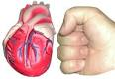
Amazing Facts about the Human Heart
The heart is about the same size as your fist.
The heart beats on average 70 times per minute; 4,200 beats per hour; 100,000 beats per day; 365 million beats per year; 30 billion beats in an average life time of 80 years.
An adult heart pumps 7,500 liters of blood daily.
It takes about 20 seconds to pump blood to every cell in your body.
If you lined up all the blood vessels in your body end-to-end, they would wrap around the earth twice.

Slide 5
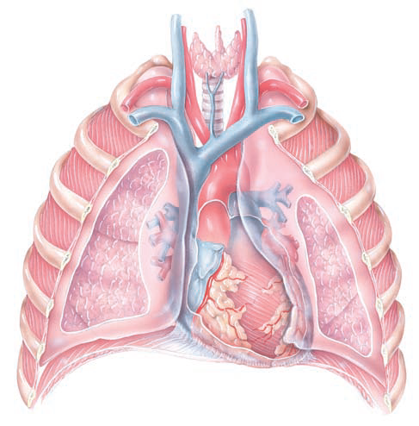
Anatomy of heart
The heart rests on the diaphragm, near the midline of the thoracic cavity.
The heart lies in the mediastinum, an anatomical region that extends from the sternum to the vertebral column, from the first rib to the diaphragm, and between the lungs.
Heart is covered by a membrane called pericardium.
Base of heart
Apex of heart
Diaphragm

Slide 6
Pericardium
The membrane that surround and protects the heart.
It confines the heart into its position in the mediastinum, while allowing sufficient movement for vigorous and rapid contraction.
It consists of 2 parts: Fibrous pericardium and Serous pericardium
Superficial Fibrous pericardium:
Composed of tough, inelastic, dense irregular connective tissue.
Its open end is fused to the connective tissues of the blood vessels entering and leaving the heart.
It prevents the out stretching of heart, provides protection, and anchors the heart in mediastinum.
At apex it is slightly fused with diaphragm.

Slide 7
Pericardium
Serous pericardium
Thinner, more delicate membrane that forms a double layer around heart.
The outer parietal layer of the serous pericardium is fused to the fibrous pericardium.
The inner visceral layer of serous pericardium- epicardium
Between the two layer is a space that contains a few milliliters of pericardial fluid called pericardial cavity.
This fluid helps in reduction of friction between the layers of serous pericardium as heart moves.

Slide 8
Layers of heart
Walls of heart has 3 layers:
Epicardium
The epicardium is composed of two tissue layers. The outermost is called the visceral layer of the serous pericardium. It houses major coronary and cardiac vessels of the heart.
Myocardium
Responsible for pumping action of heart and composed of cardiac muscle tissue.
Endocardium
A thin layer of endothelium overlying a thin layer of connective tissue.
It provides the smooth lining for the chambers of the heart and covers the valves of heart.

Slide 9
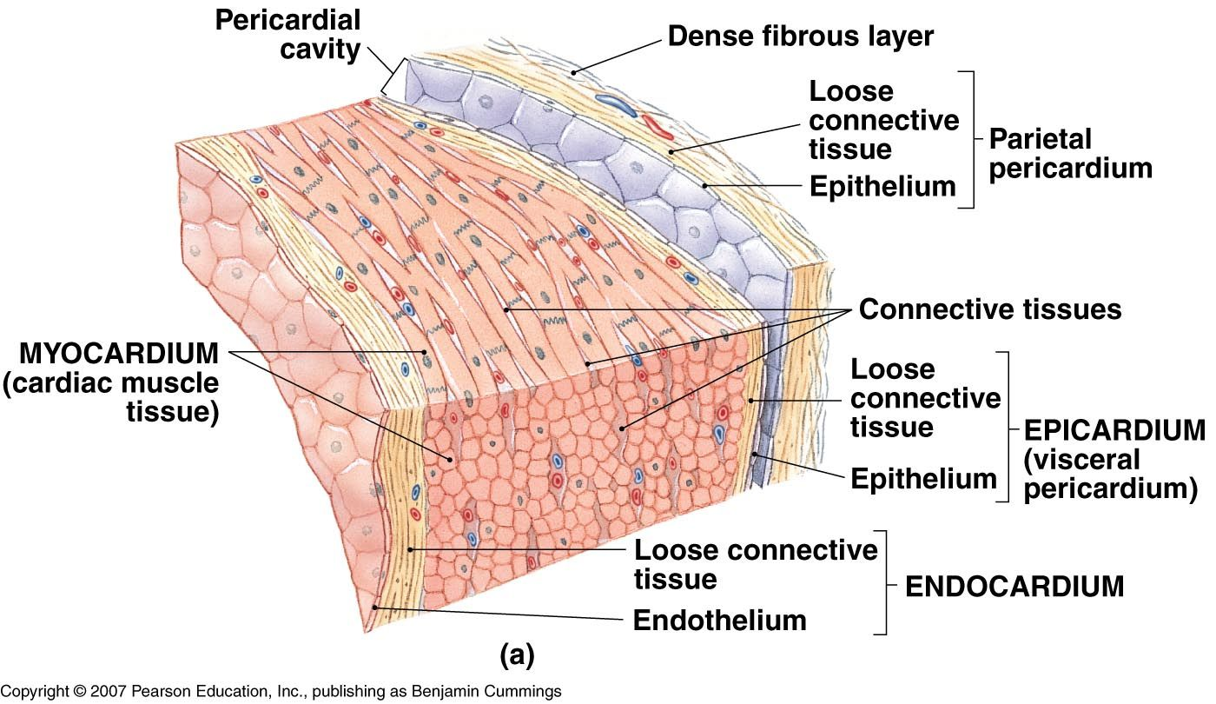

Slide 10
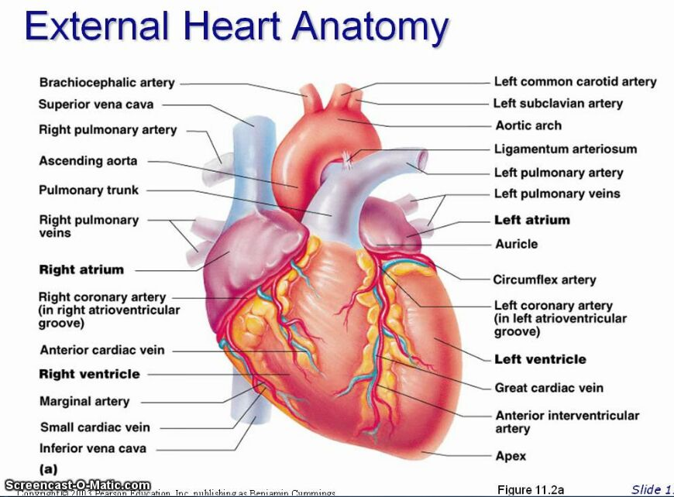
Sulci: series of grooves that contains coronary blood vessels and variable amount of fat.
Each sulcus marks the external boundary between two chambers
Coronary sulcus- marks the external boundary between the superior atria and inferior ventricles
Anterior interventricular sulcus
Posterior interventricular sulcus

Slide 11
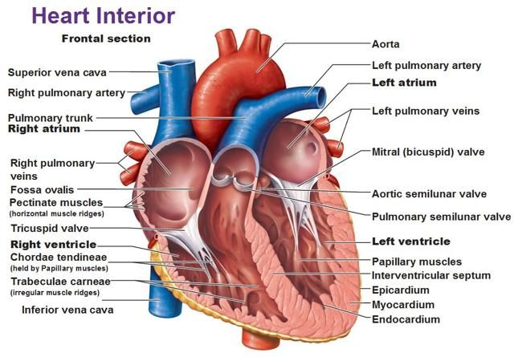
Chambers of heart

Slide 12
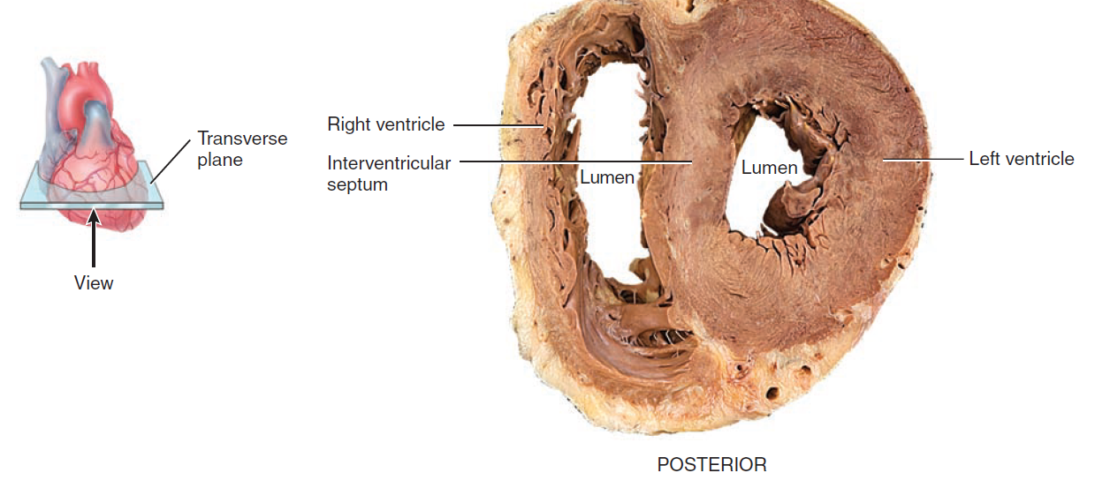
Comparison of left and right ventricles

Slide 13
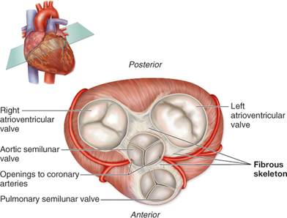
Fibrous skeleton of heart
A dense connective tissue that forms fibrous skeleton of heart.
There are 4 rings that surrounds the valve and form structural foundation of heart valve.
It prevents overstretching of valves as blood passes through them.
Act as an electrical insulator between the atria and ventricles.

Slide 14
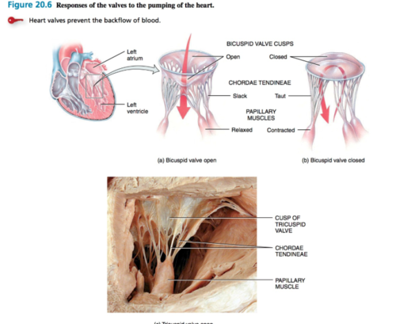
Heart valves
Heart valves open and close as response to pressure changes as heart contracts and relaxes.
Ensure one way flow of blood
Regurgitation

Slide 15
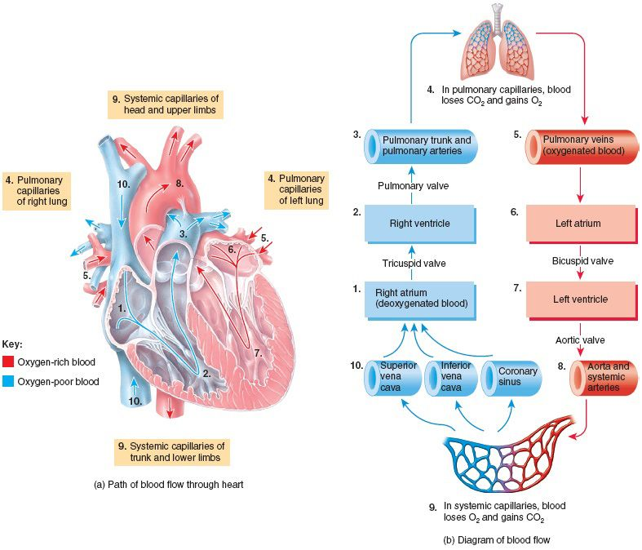
Systemic and pulmonary circulation

Slide 16
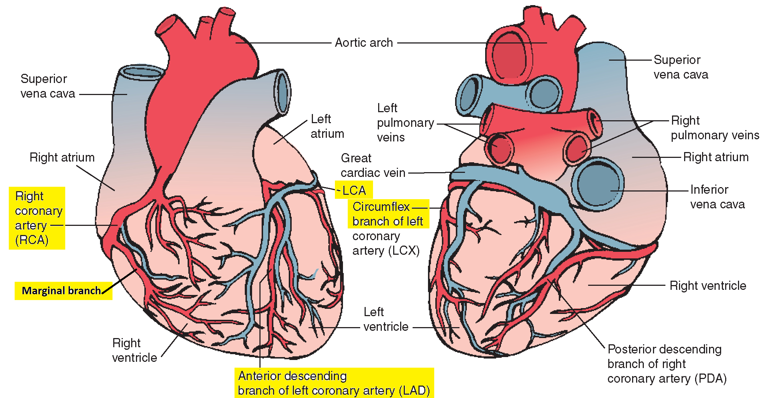
Coronary circulation and collateral circulation
Reperfusion- blockage of coronary artery deprive heart muscles from oxygen
Anastomoses
Collateral circulation

Slide 17
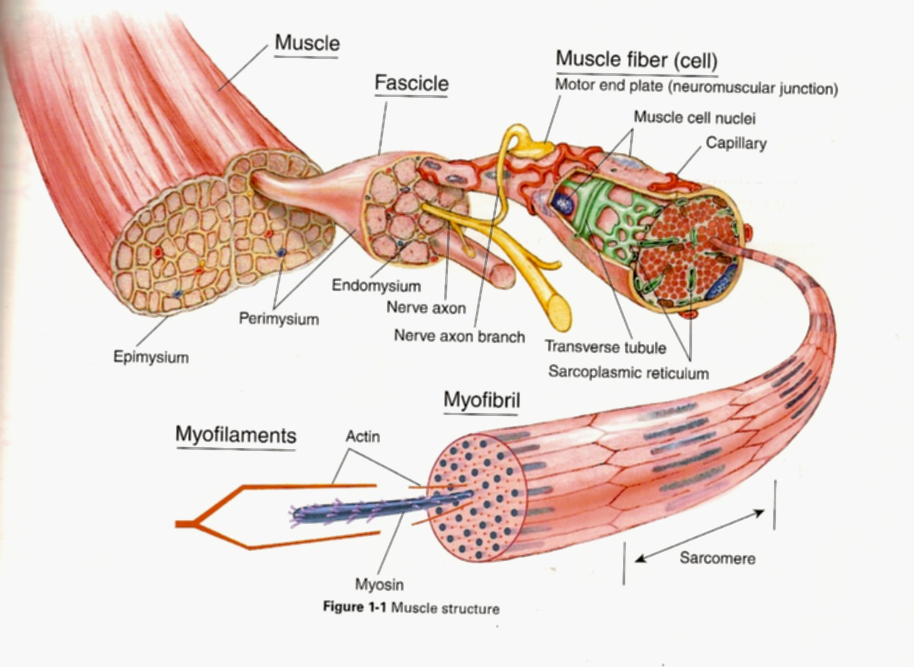
Muscle tissue

Slide 18
How much you know?
Define the terms?
Auricle
Atria
Aorta
Ventricle
Papillary muscles
Name of all 4 valves
Chordae tendineae
Coronary vein
Pulmonary vein
Systemic flow
Pulmonary circulation
Coronary circulation

Slide 19
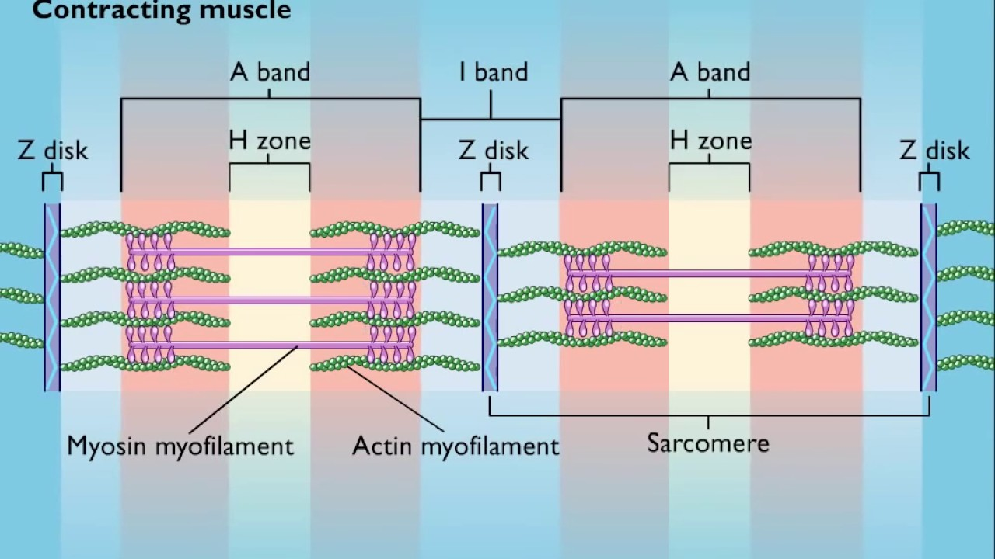

Slide 20
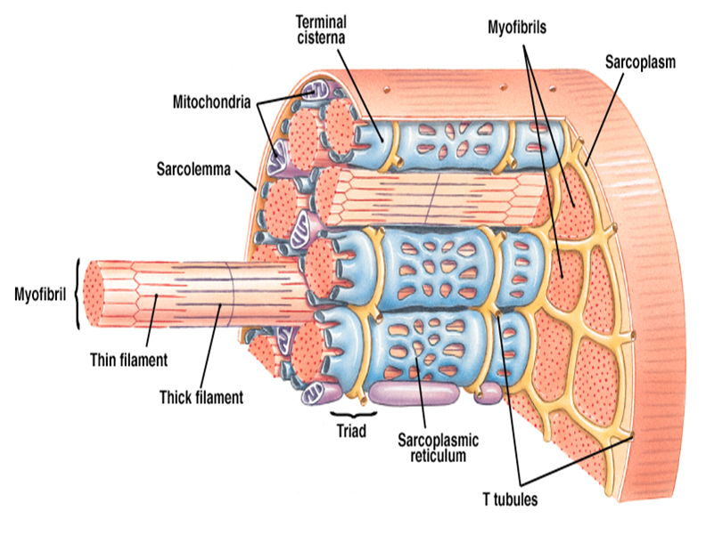
Cardiac Muscle

Slide 21
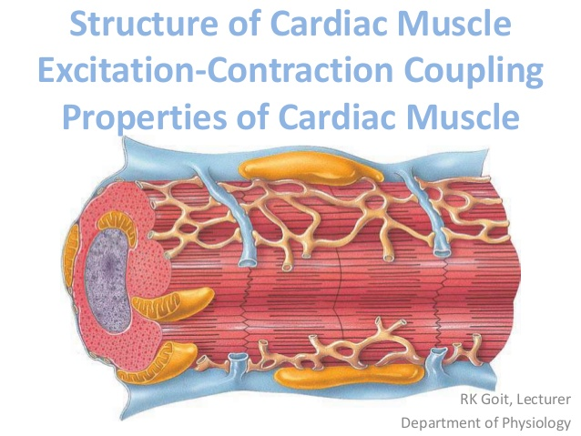
Cardiac Muscle
They are shorter in length and less circular in transvers section.
Exhibit branching
The ends of cardiac muscle fibers connect to neighboring fibers by irregular transvers thickenings of the sarcolemma called intercalated disk.
The disk contains desmosomes and gap junctions.
Large numbers of mitochondria (25%).
Small sarcoplasmic reticulum indicates less storage of calcium ions.

Slide 23
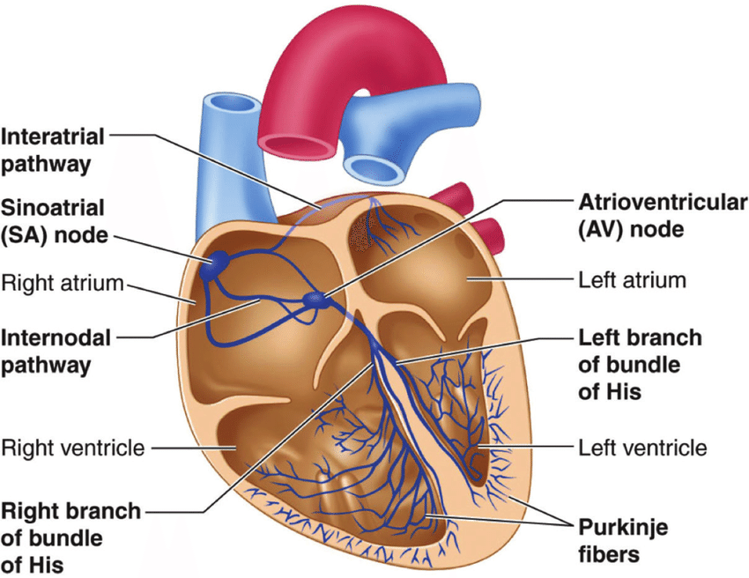
Auto rhythmic fibers
“Surgeons are better plumbers than electricians”
ANS and epinephrine can modify the timing and strength of each heart beat.

Slide 24
Auto rhythmic fibers
On their own, auto rhythmic fibers in the SA node would initiate an action potential about every 0.6 second, or 100 times per minute. Thus, the SA node sets the rhythm for contraction of the heart—it is the natural pacemaker.
This rate is faster than that of any other auto rhythmic fibers. Because action potentials from the SA node spread through the conduction system and stimulate other areas before the other areas are able to generate an action potential at their own, slower rate, the SA node acts as the natural pacemaker of the heart.
Nerve impulses from the autonomic nervous system (ANS) and blood-borne hormones (such as epinephrine) modify the timing and strength of each heartbeat, but they do not establish the fundamental rhythm.

Slide 25
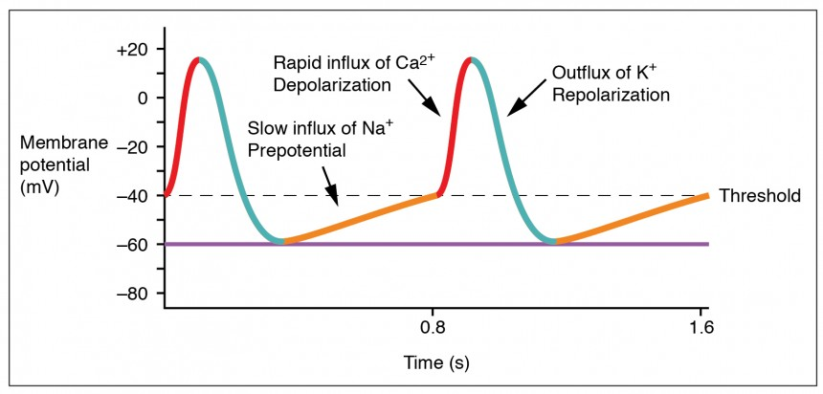
SA node action potential

Slide 26
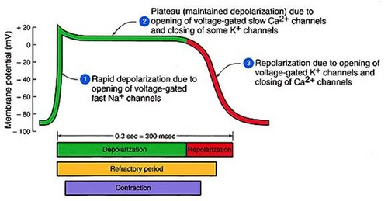
Action potential and contraction of contractile fibers

Slide 27
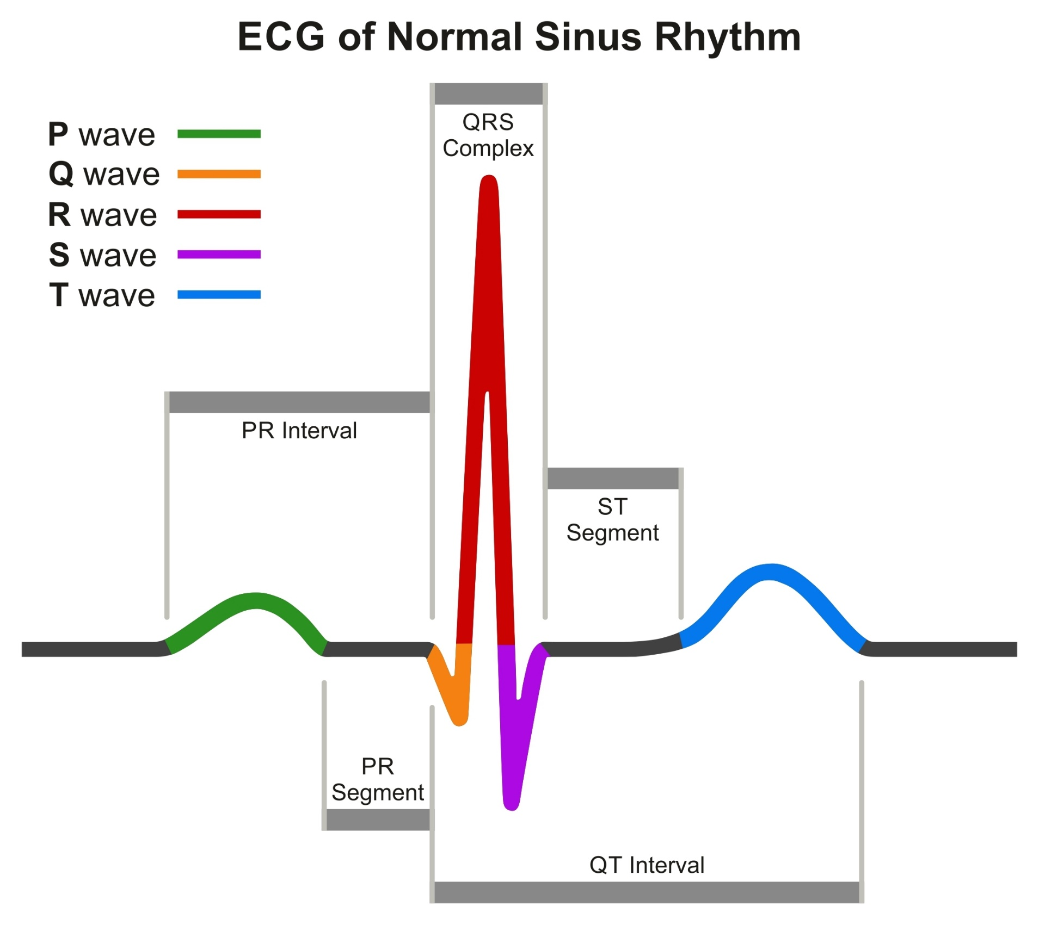
ECG
Electrocardiogram
Electrocardiograph
Enlargements:
Large P wave- arterial enlargement
Enlarged Q wave- myocardial infraction
Enlarged R wave- enlarged ventricles
Flatten T wave- insufficient oxygen
Lengthen P-Q – coronary artery disease

Slide 28
ECG
By comparing ECG with one another and with normal records, it is possible to determine
(1) if the conducting pathway is abnormal, (2) if the heart is enlarged, (3) if certain regions of the heart are damaged, and
(4) the cause of chest pain
Size wise information:
1) Larger P waves indicate enlargement of an atrium;
2) an enlarged Q wave may indicate a myocardial infarction; and
3) An enlarged R wave generally indicates enlarged ventricles.
4) The T wave is flatter than normal when the heart muscle is receiving insufficient oxygen—as, for example, in coronary artery disease.
5) The T wave may be elevated in hyperkalemia (high blood K level).
Interval and segments:
1) the P–Q interval lengthens- coronary artery disease and rheumatic fever.
2) The S–T segment is elevated (above the baseline) in acute myocardial infarction and depressed (below the baseline) when the heart muscle receives insufficient oxygen.

Slide 29
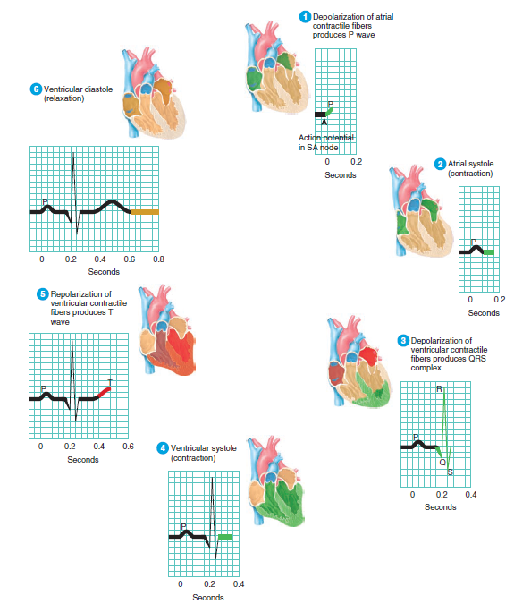

Slide 30
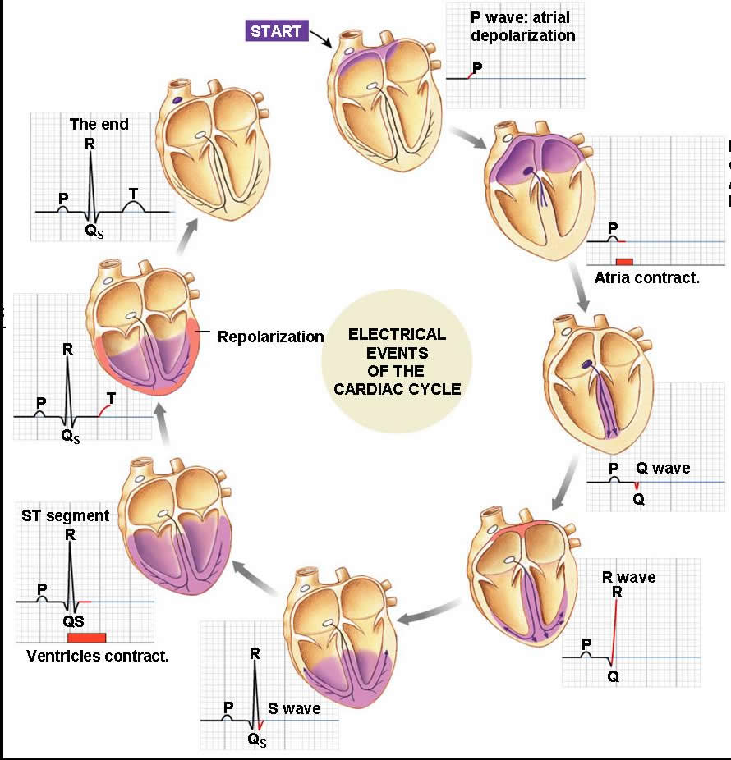

Slide 31
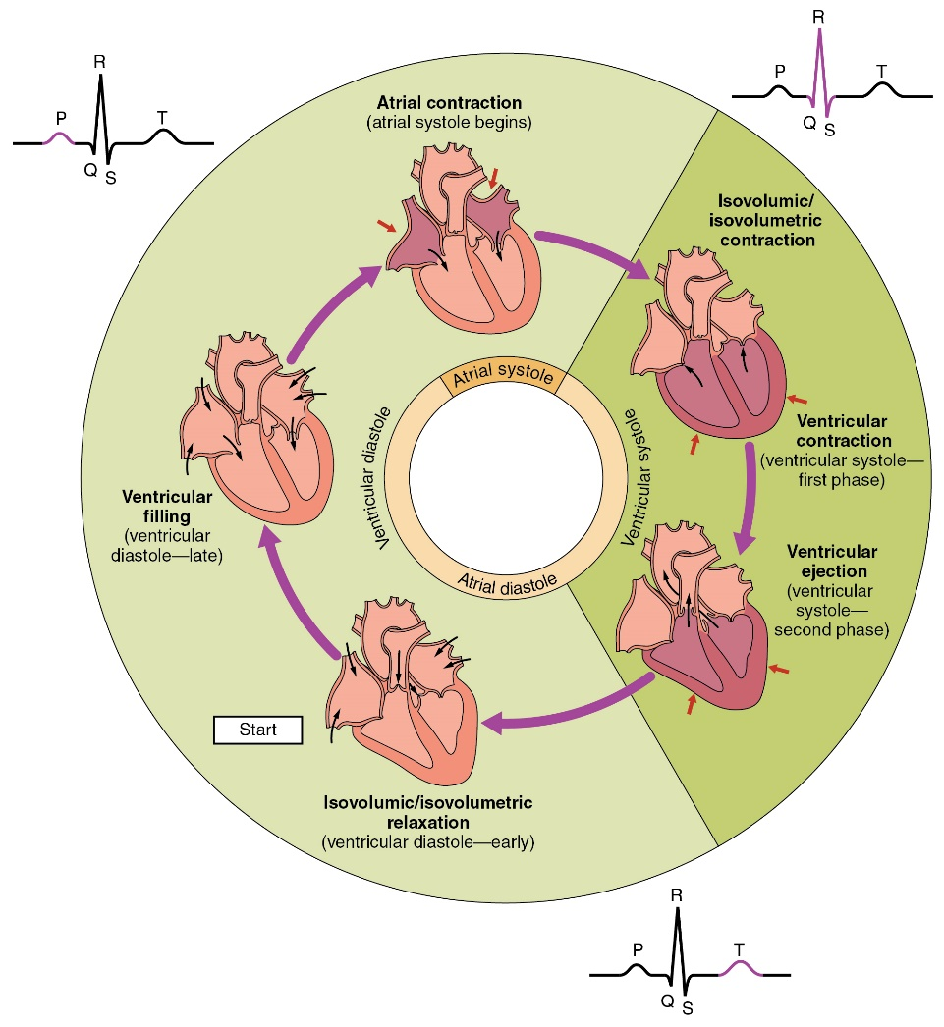
Cardiac cycle
Cardiac Cycle

Slide 32
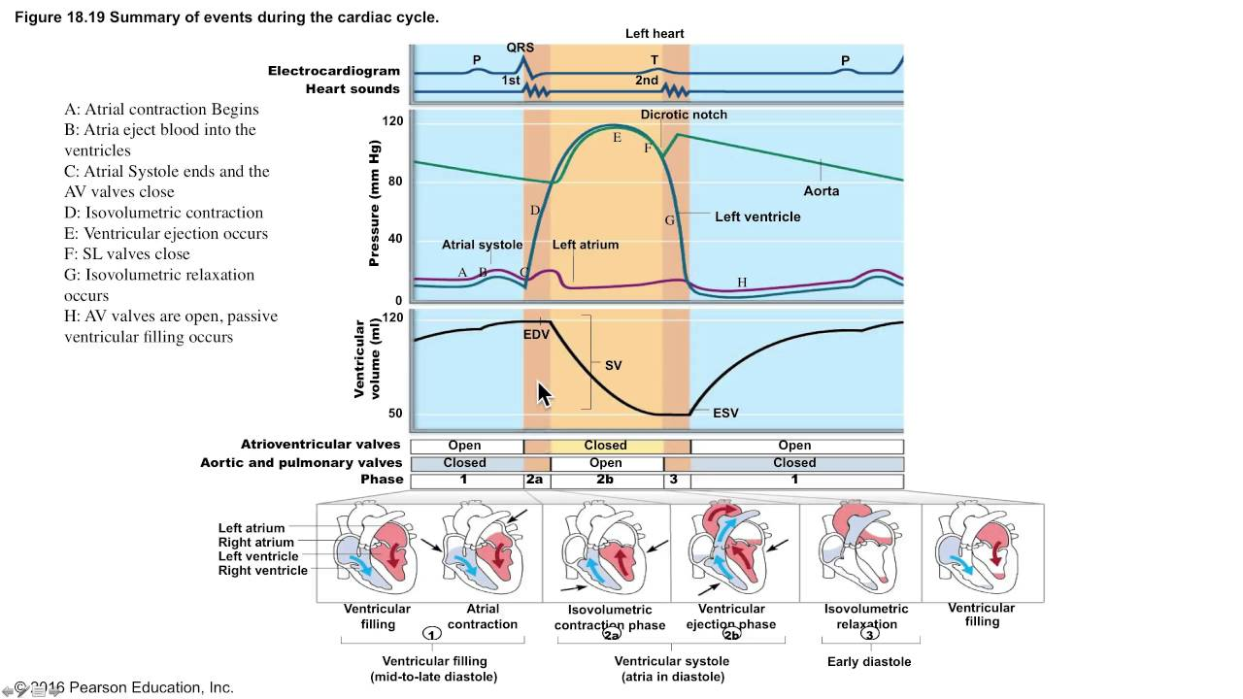

Slide 33
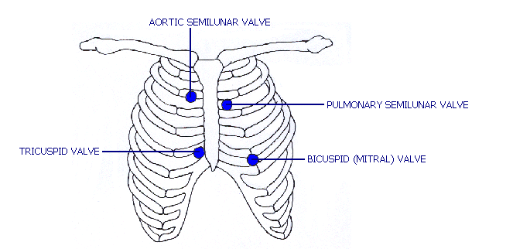
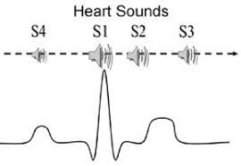
Heart sounds
S1- closure of AV valves
S2-closure of SL valves
Third sound- rushing of blood during ventricular filling
Fourth sound- contraction of atrial muscles

Slide 34
Cardiac output
Volume of blood ejected from the left ventricle into the aorta each minute.
CO=SV(70mL/beat) x HR(75 beats/min)=5,250mL/min
Cardiac reserve: is the difference between a person’s maximum cardiac output and cardiac output at rest.
End diastolic volume
End systolic volume
Ejection fraction: fraction of EDV that is ejected out by each ventricles. It is 54%, 70mL of 130mL (EDV).
EDV-SV=ESV
Regulation of stroke volume:
3 factors regulate the SV and ensure that the left and right ventricles pump equal volume of blood.
a) Preload b)Contractility c)Afterload

Slide 35
Volume changes in each heart beat per ventricle
ESV left from previous heart beat | 60ml
Passively added to the ventricle during arterial systole | +30ml
Added by atrial systole | +40ml
EDV | 130ml
Stroke volume ejected by ventricular systole | -70ml
Leave: End-systolic volume | 60ml
Remember both ventricles eject same amount of blood even though pressure in right ventricle is 25mmHg and on left side 120mmHg.
It is required to maintain homeostasis.
If right ventricle pumps more blood into the lungs than left – blood accumulates in lungs, causing pulmonary hypertension, edema, and a risk of drowning in one’s own body fluid.
If left ventricle pumps more blood- blood accumulate in systemic circulation, causing hypertension and systemic edema (dropsy).
In principle, if the output of the left ventricle were just 1% greater than output of the right, it would completely drain the lungs of blood in less than 10 minutes (although death would occur much sooner).
Fluid accumulation in either circuit due to insufficiency of ventricular pumping is called congestive heart failure.

Slide 36
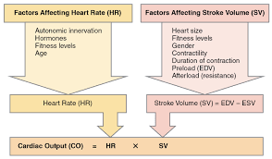
Factors affecting cardiac output

Slide 37
Physiological variations in cardiac output
Age
Gender
Body Build
Diurnal Variations
Environment temperature
Emotional condition
After meals
Exercise
High altitudes
Posture
Sleep
pregrnancy

Slide 38
Pathological variations
Increase in cardiac output
Fever
Anemia
Hyperthyroidism
Decrease in cardiac output
Hypothyroidism
Atrial fibrillation
Incomplete heart block
Congestive heart failure

Slide 39
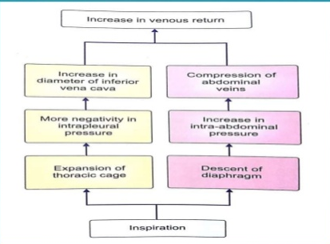
Factors maintaining cardiac output
Venous return
Heart rate
Peripheral resistance
Force of contraction

Slide 40
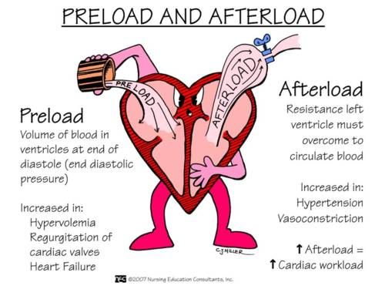
Regulation of SV
Preload
Ventricular filling (EDV)
Duration of Venous
ventricular diastole return
Preload(effect of stretching) the degree of stretch on the heart before it contracts (more diastole more contraction) SV proportional EDV
Afterload(pressure that must be overcome before a semilunar valve can open. An increase in afterload causes stroke volume to decrease.
Contractility the forcefulness of contraction of individual ventricular muscle fibers at any given preload. Ca++ inotropic positive agent.

Slide 41
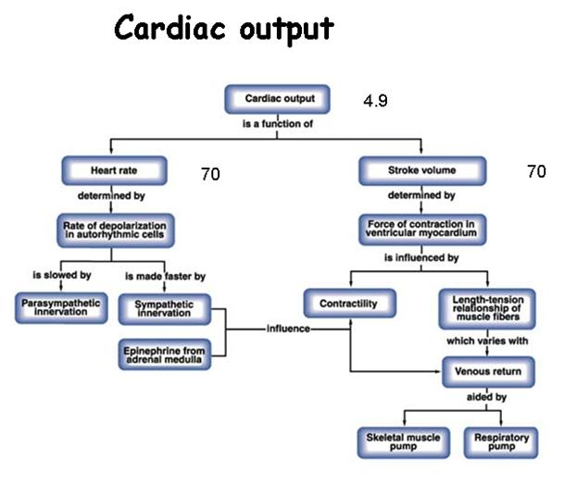
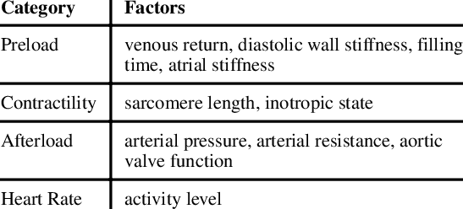

Slide 42
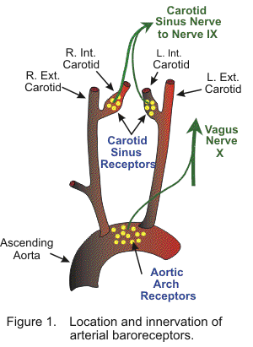
Heart Rate
Normal range: 60 to 80 beats
Tachycardia : above 100 beats per minute
Bradycardia : below 60 beats per minutes
Regulation of heart rate
Vasomotor center
Motor nerve fibers
Sensory nerve fibers

Slide 43
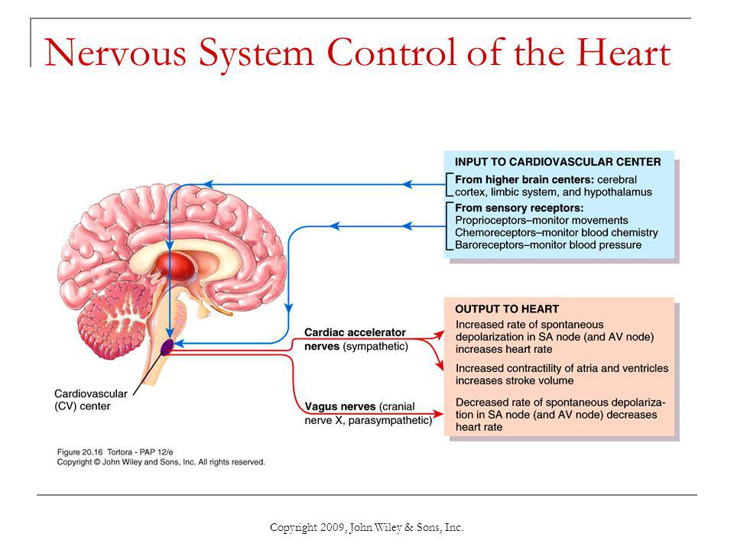
Regulation of heart rate

Slide 44
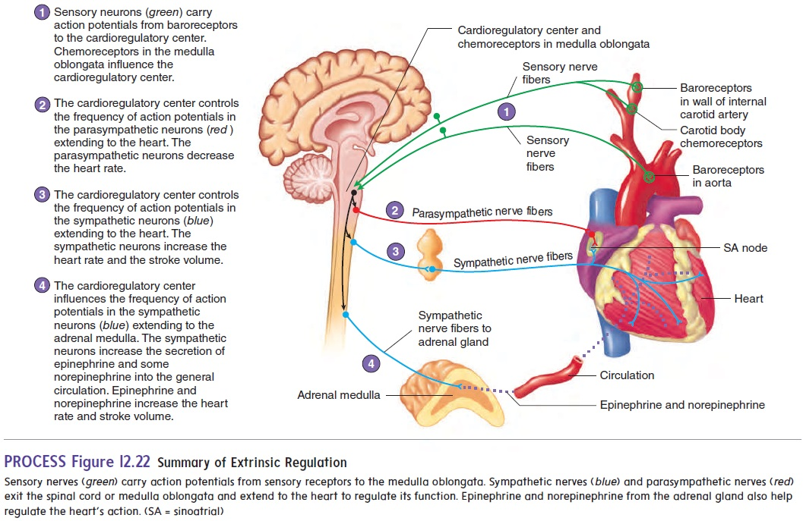
Regulation of heart rate

Slide 45
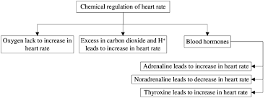
Chemical regulation

Slide 46
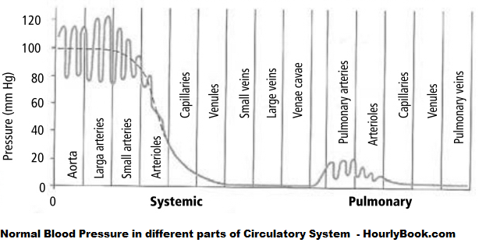
Blood pressure
The hydrostatic pressure exerted by blood on the walls of a blood vessel.
It is determined by Cardiac output, blood volume and vascular resistance.
MAP=DP+(1/3)(SP-DP)
MAP=CO x R

Slide 47
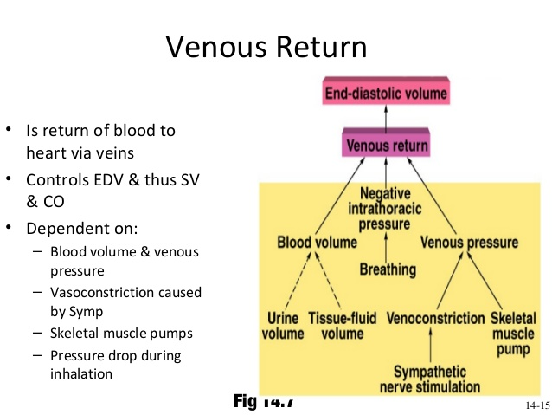
Vascular resistance
It is the opposition of blood flow due to friction between blood and walls of blood vessels.
VR depends on :
Size of blood vessel lumen (Rα 1/d⁴ )
Blood viscosity :depends mostly on ratio of RBC to plasma volume and concentration of protein.
Total blood vessel length
Systemic vascular resistance

Slide 48
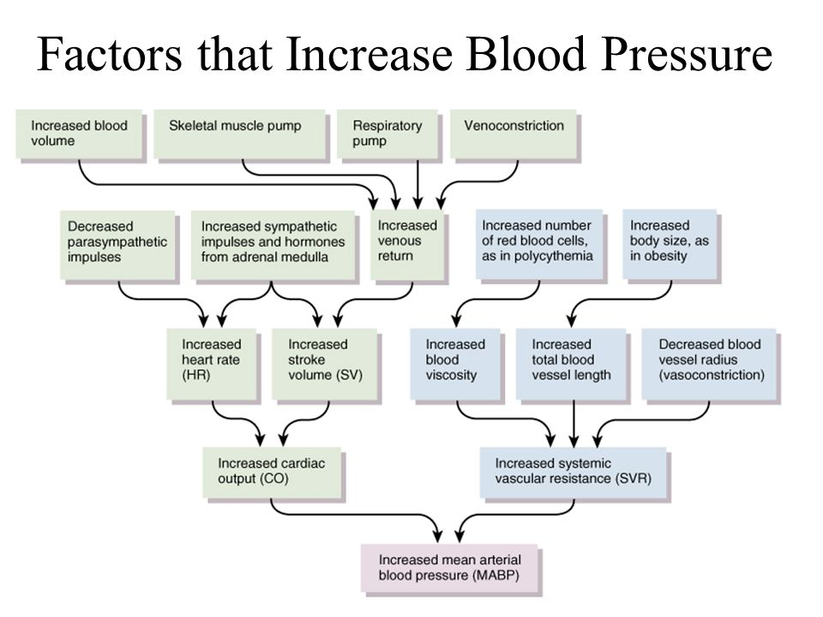

Slide 49
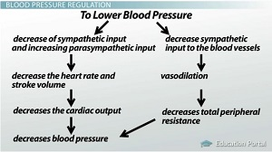
Regulation of blood pressure
Nervous system
Renal mechanism
Hormonal mechanism
Local mechanism
Vasomotor center
Vasoconstrictor fibre
Vasomotor tone

Slide 50
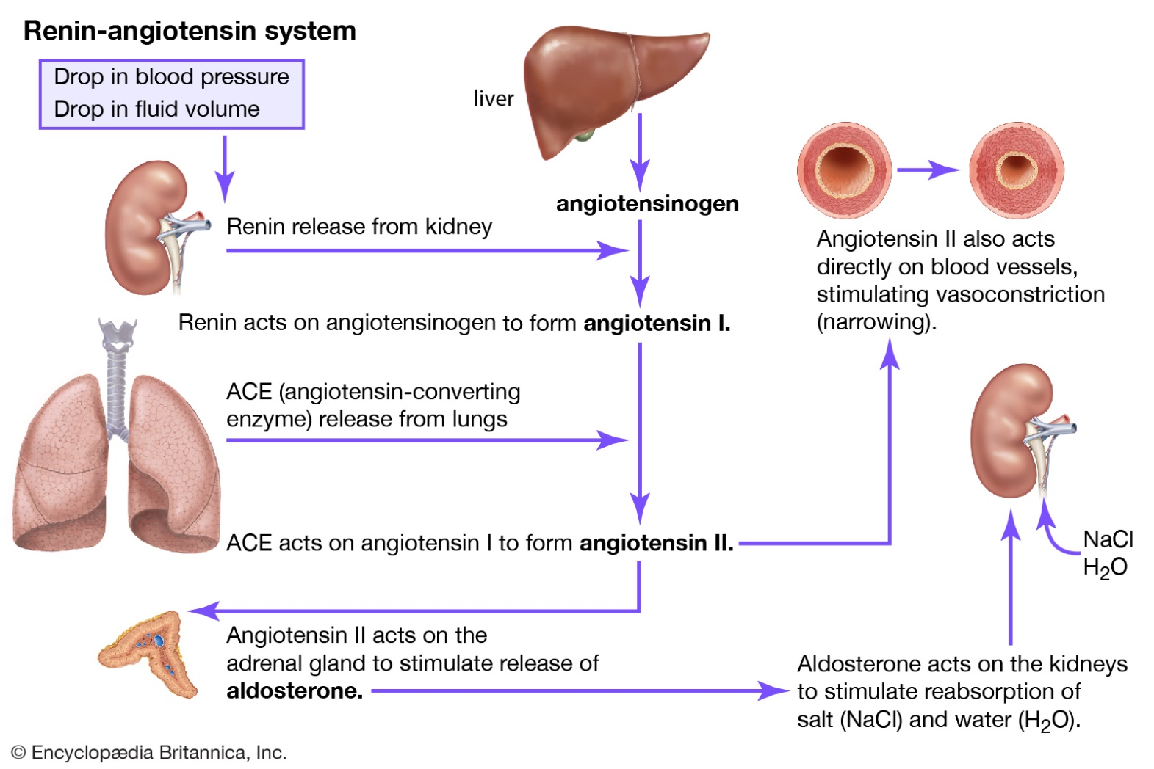

Slide 51
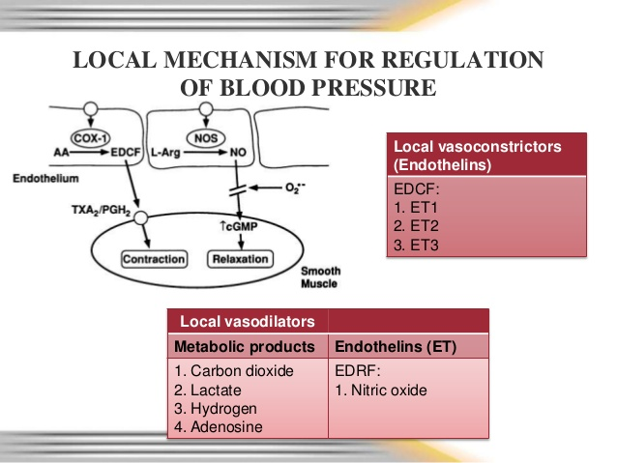

Slide 52
Hormonal mechanism
Adrenaline : it increases SP by increasing the force of contraction and decreases DP by decreasing peripheral resistance.
Noradrenaline: vasoconstrictor
Thyroxin: Increase SP and decrease DP
Aldosterone: retention of sodium and water
Prostaglandins : vasodilator

